Slide 1
Water Systems

Slide 2
Housekeeping
Proposal is due next week
Syllabus updated with new assignment
Zoom guest lecture on 11/15
Please submit paper critique slides to TA
TA office hours: Monday 2-4 pm N5

Slide 3
Agenda
1:00 Water System
Recap of Previous Lecture
Today’s Lecture
Q&A
2:15 Break
2:30 GCAM Tutorial
Paper Critique
Discuss Previous Assignment
New Modeling Assignment
Proposal writing

Slide 4
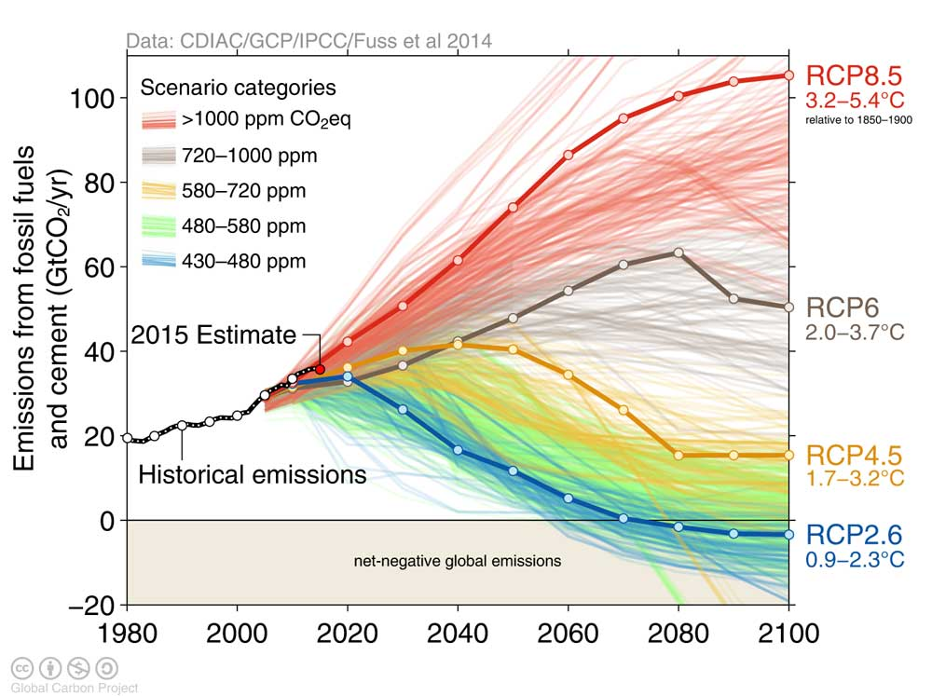
The 1.5 Degree Challenge

Slide 5
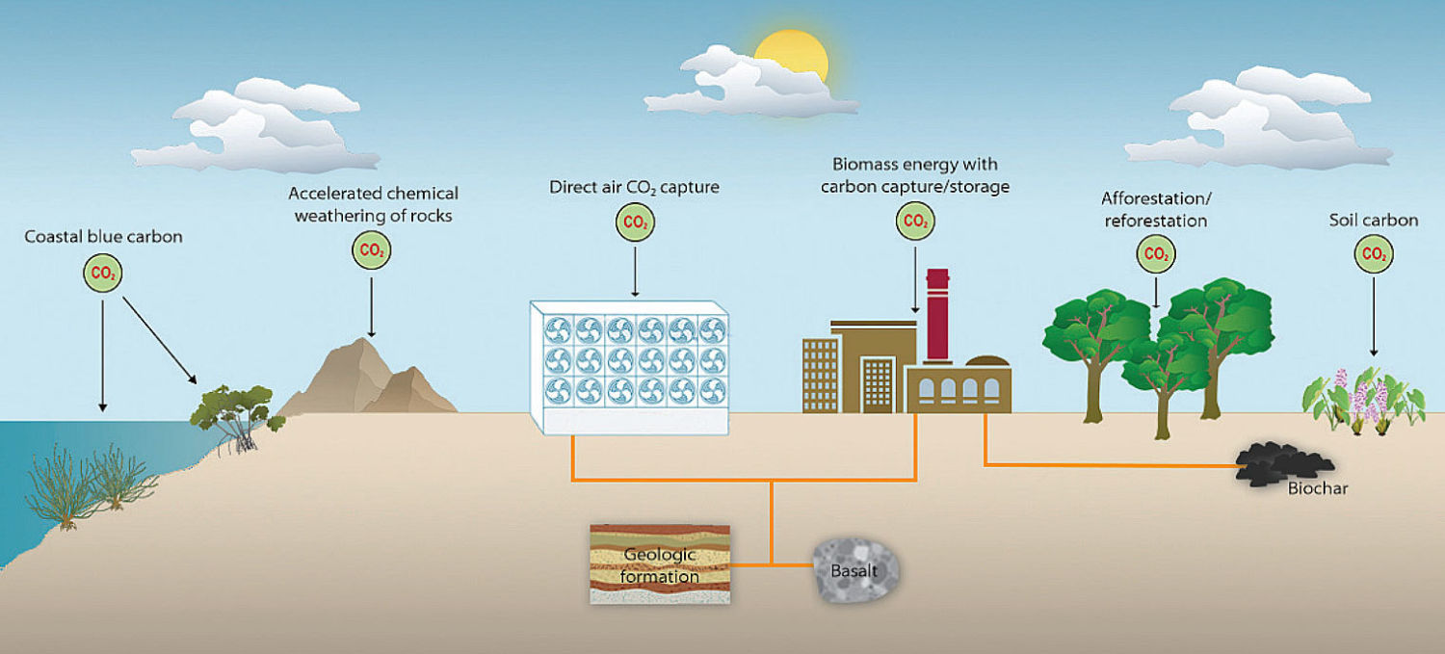
Negative Emissions Technologies
Emerging inclusion in IAM scenarios
Widespread inclusion in IAM scenarios
Image source: Adapted from NRC. Negative Emissions Technologies and Reliable Sequestration. Natl. Acad. Press (2018). doi:10.17226/25259

Slide 6
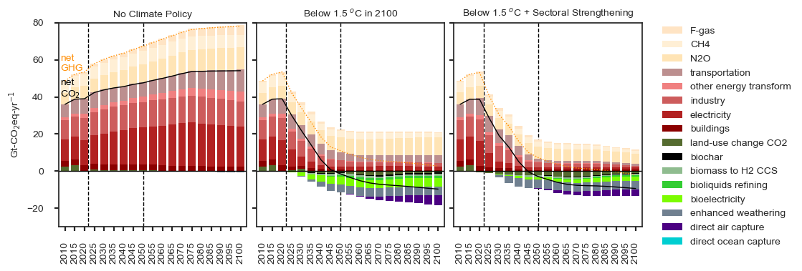
Positive and Negative GHG Emissions
10-12 GtCO₂-yr⁻¹ total CDR in 2050
nonCO₂ ~ 50% of residual emissions

Slide 7
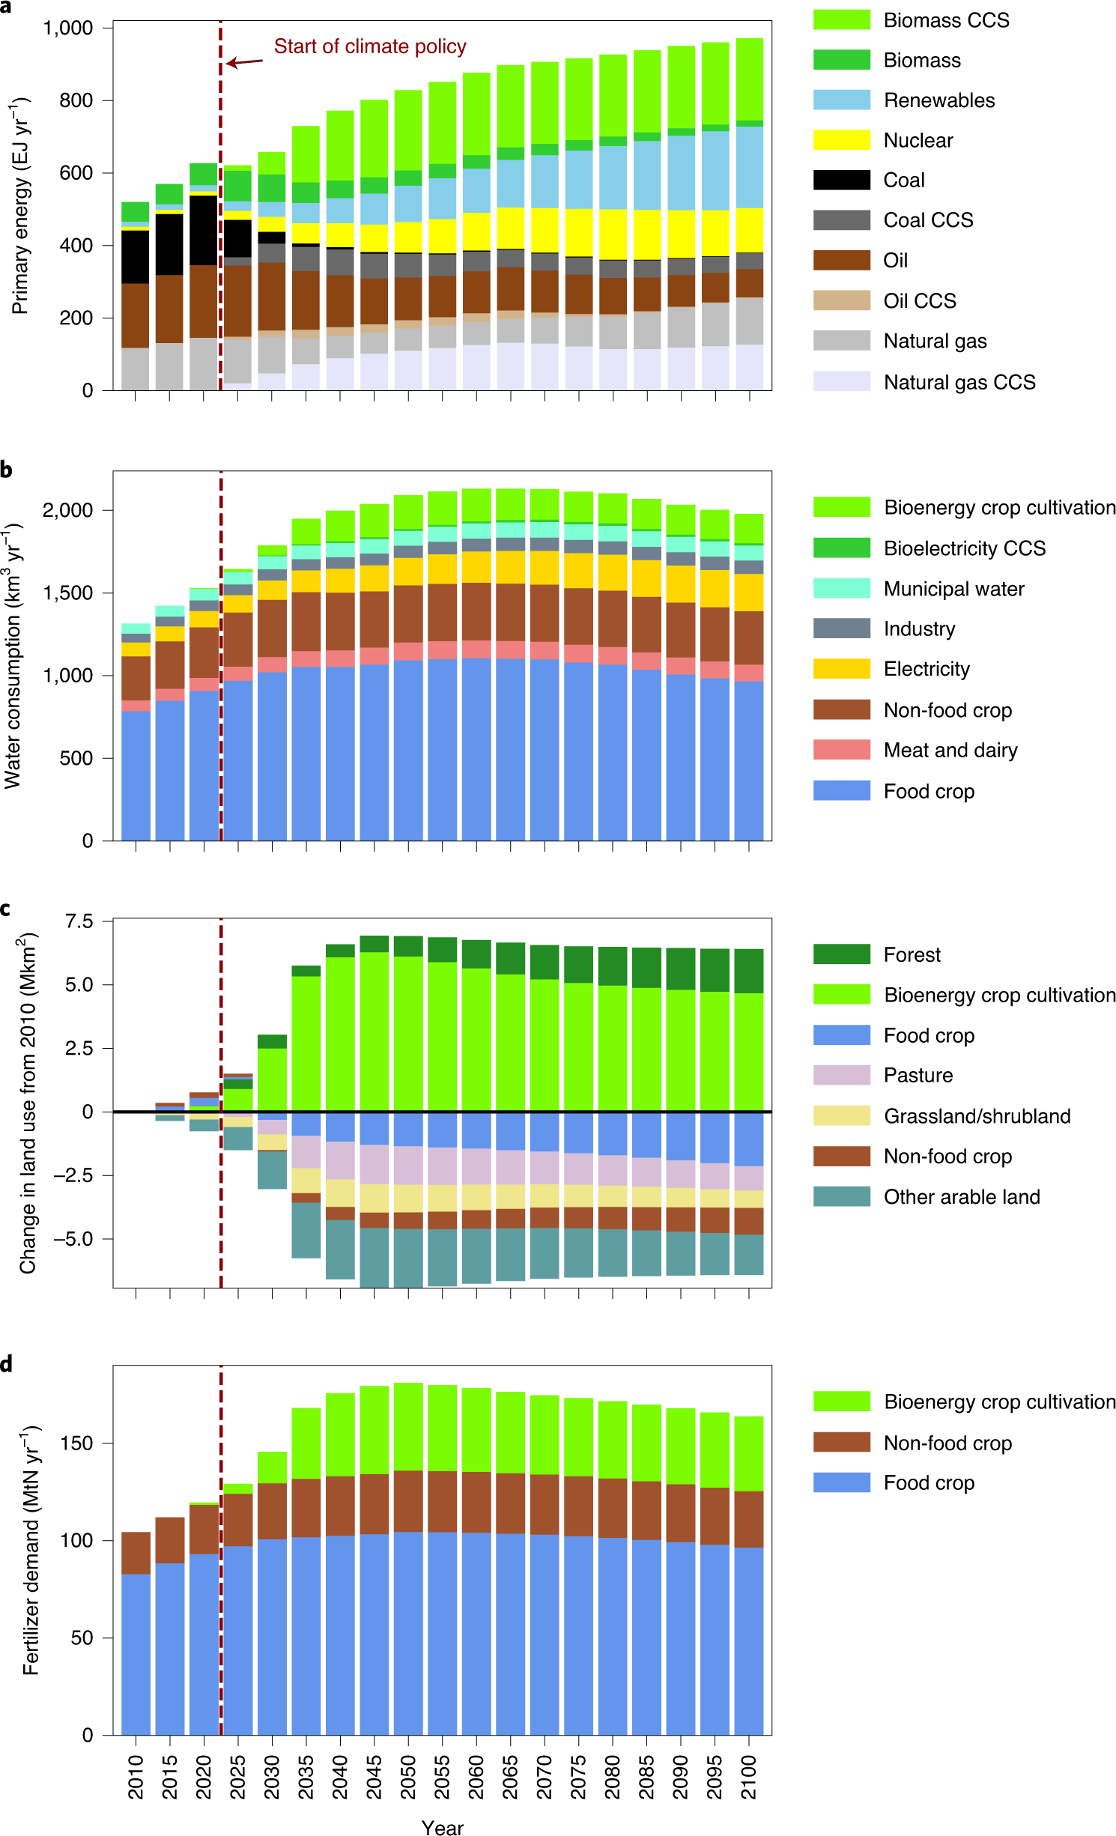
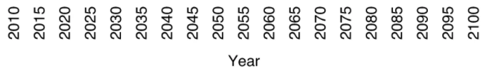
Side effects of limiting warming to 1.5 °C without DAC
a–d, Projected global energy (a), water (b), land (c) and fertilizer (d) demands for meeting a 1.5 °C end-of-century temperature target with low overshoot, assuming only BECCS and afforestation/reforestation will be available for negative emissions. The high-overshoot case could not be solved without the availability of DAC.

Slide 8
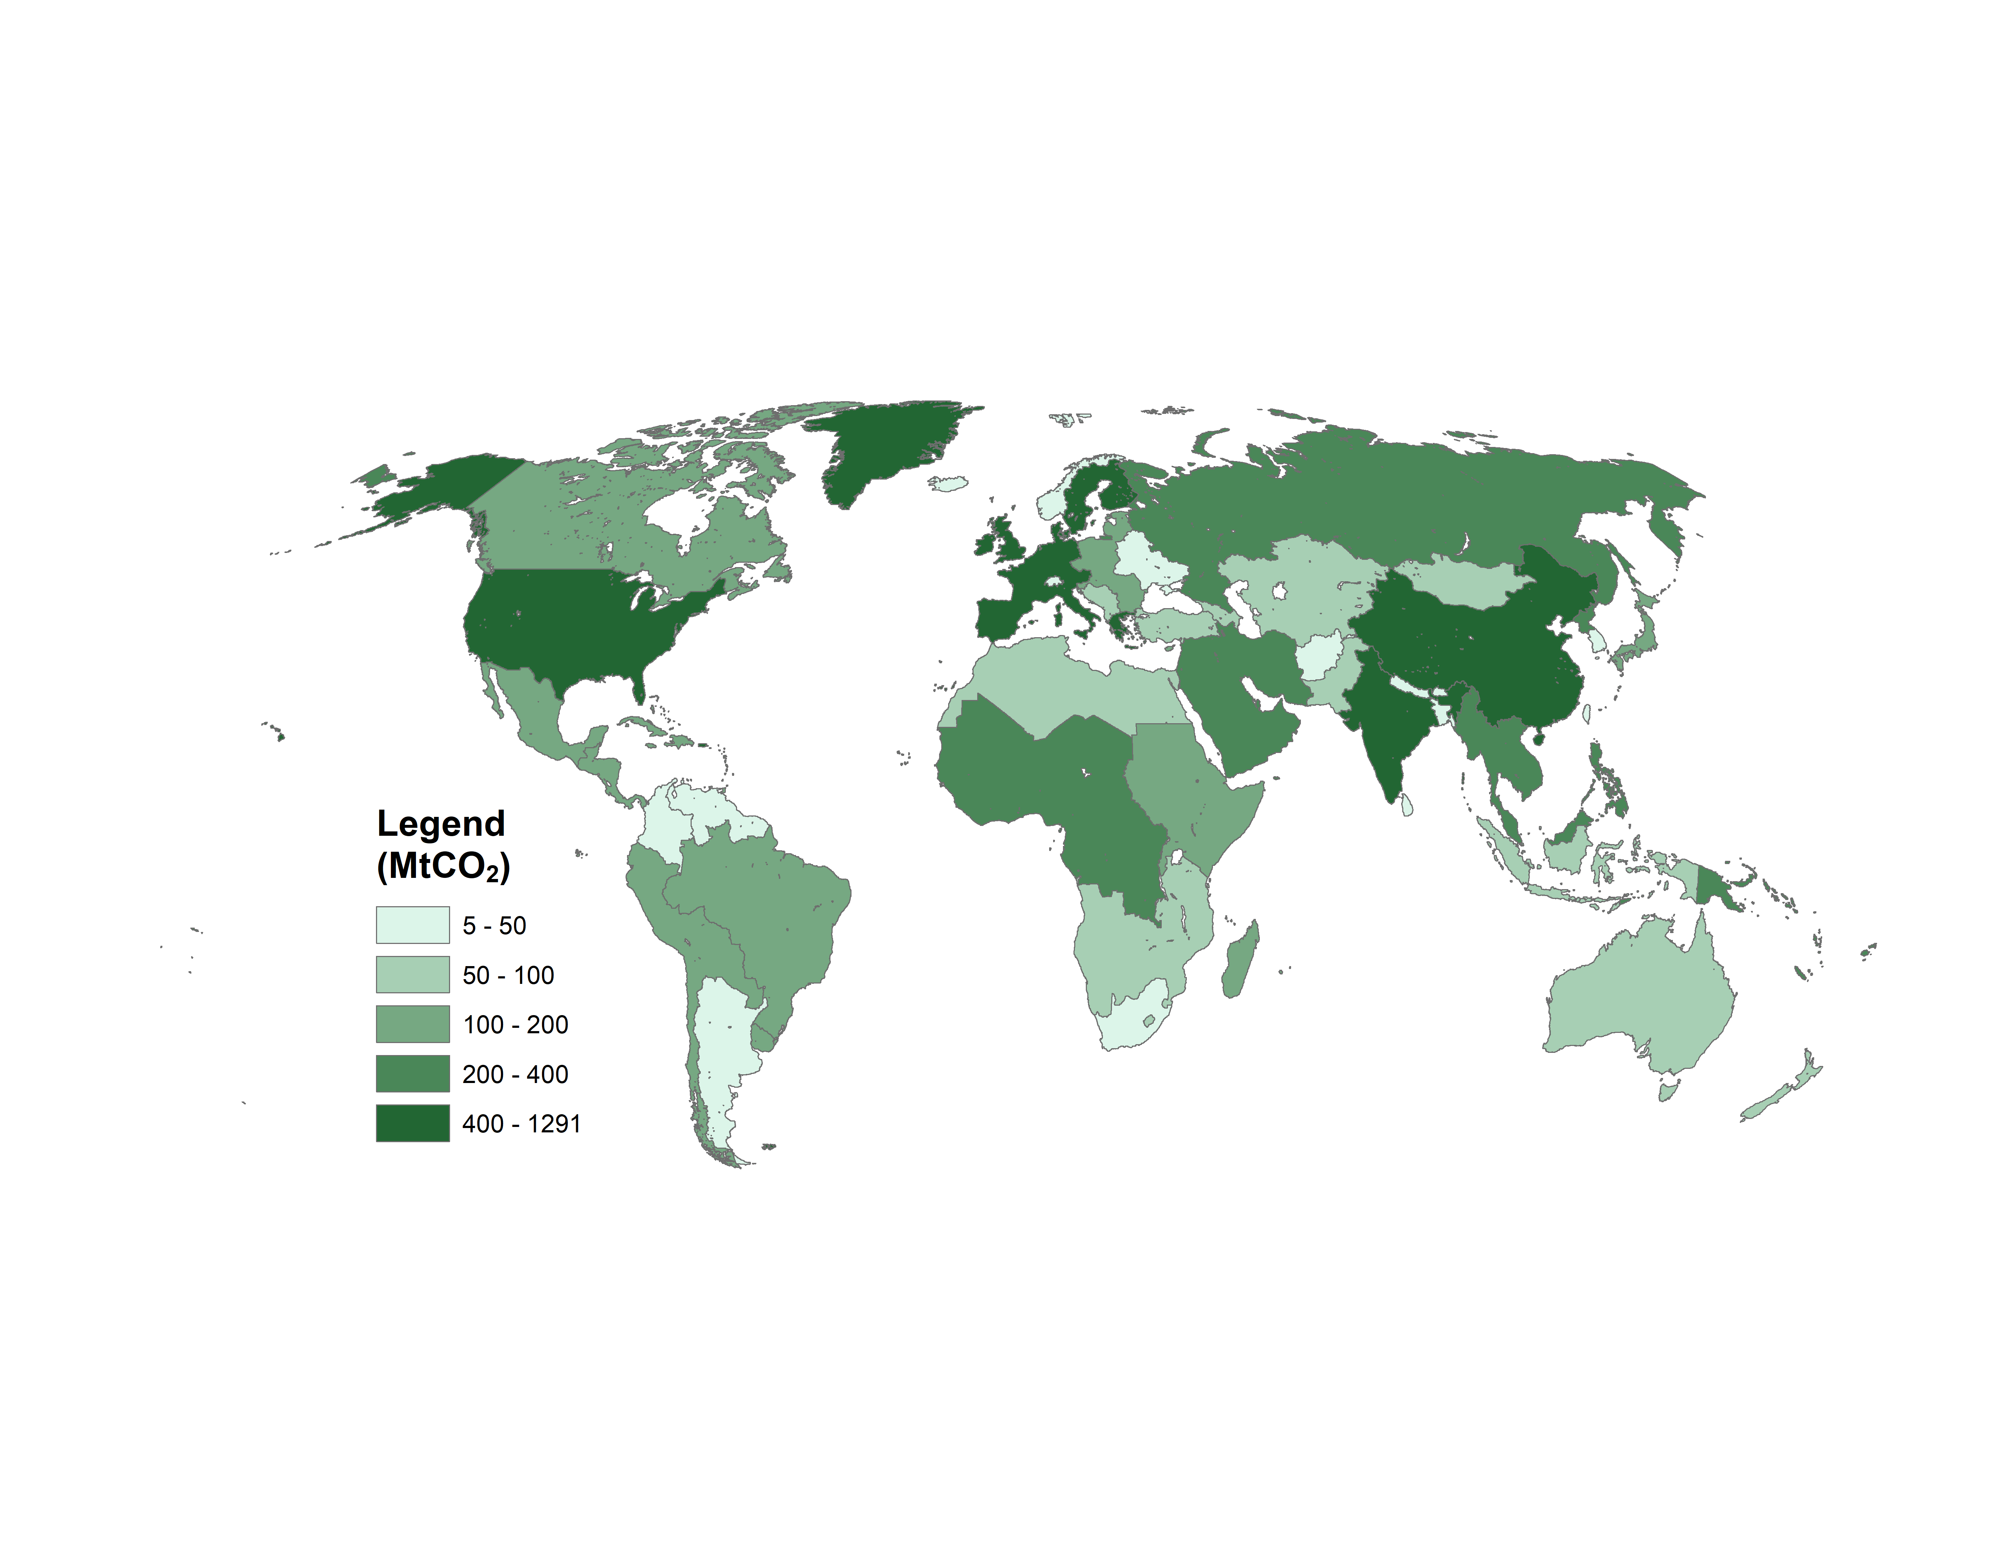
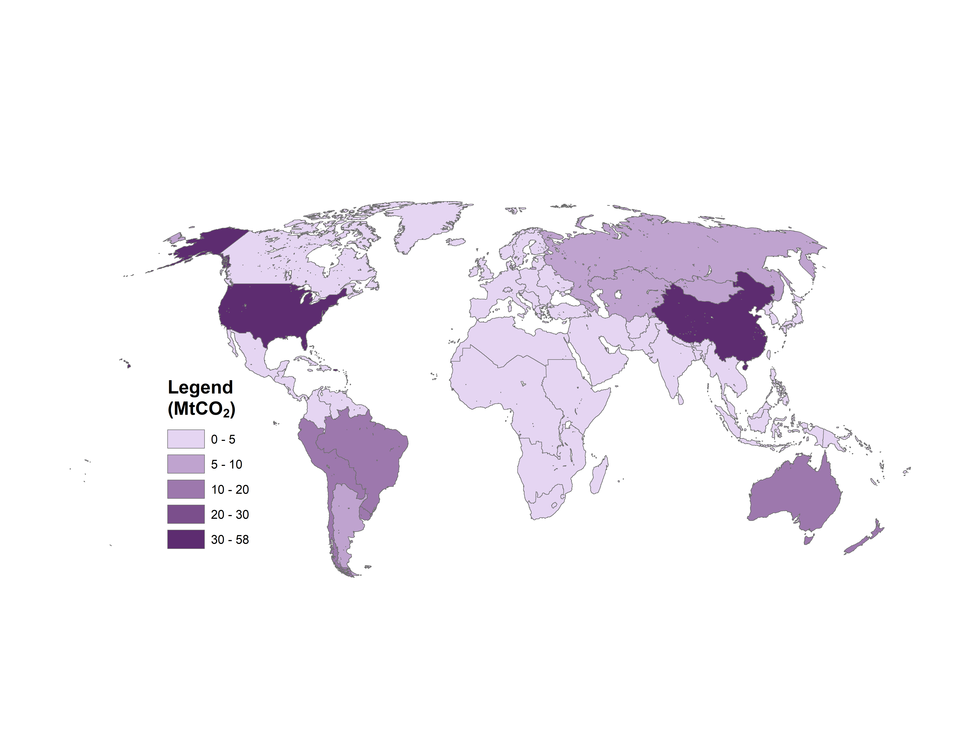
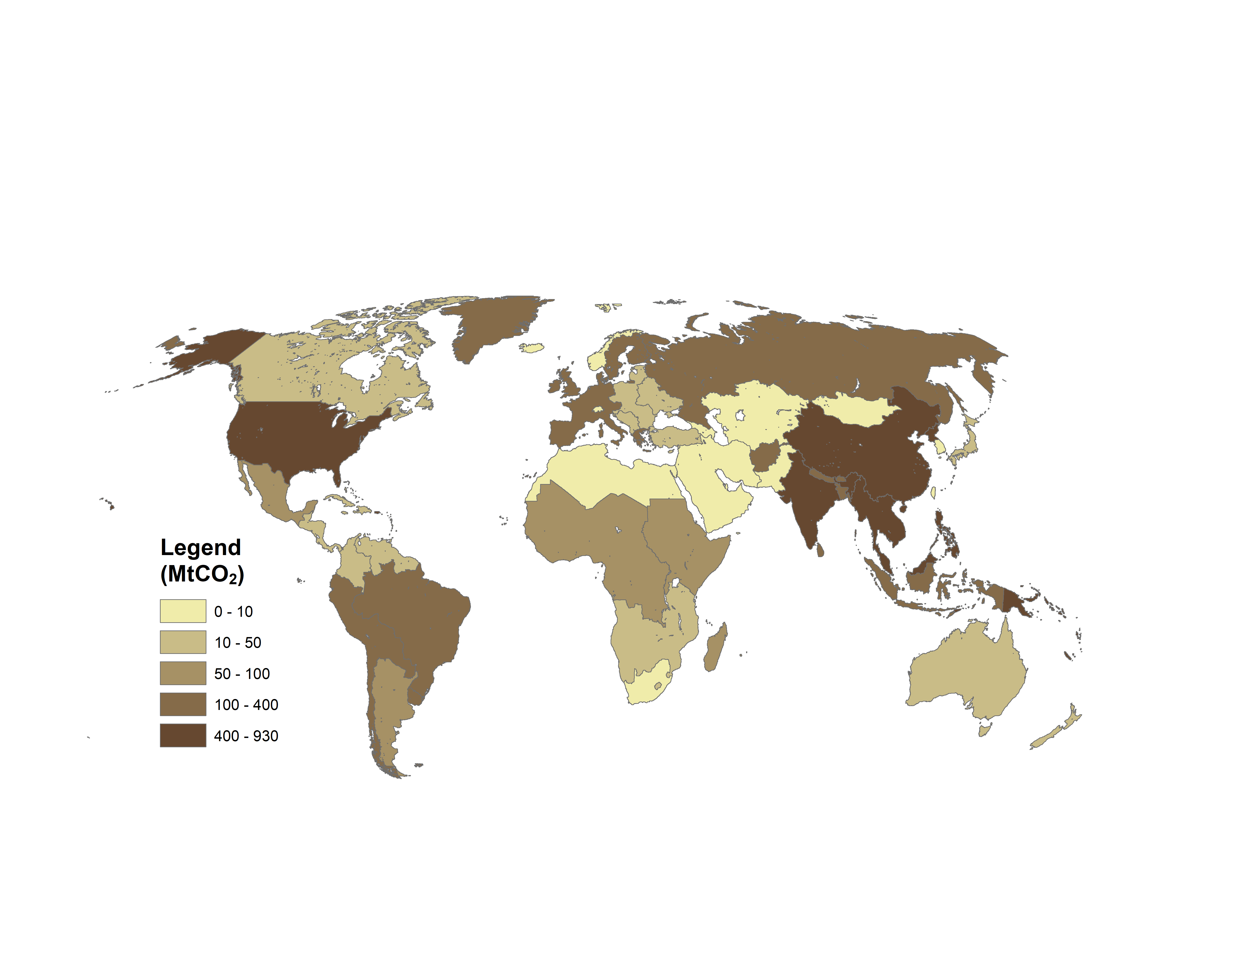
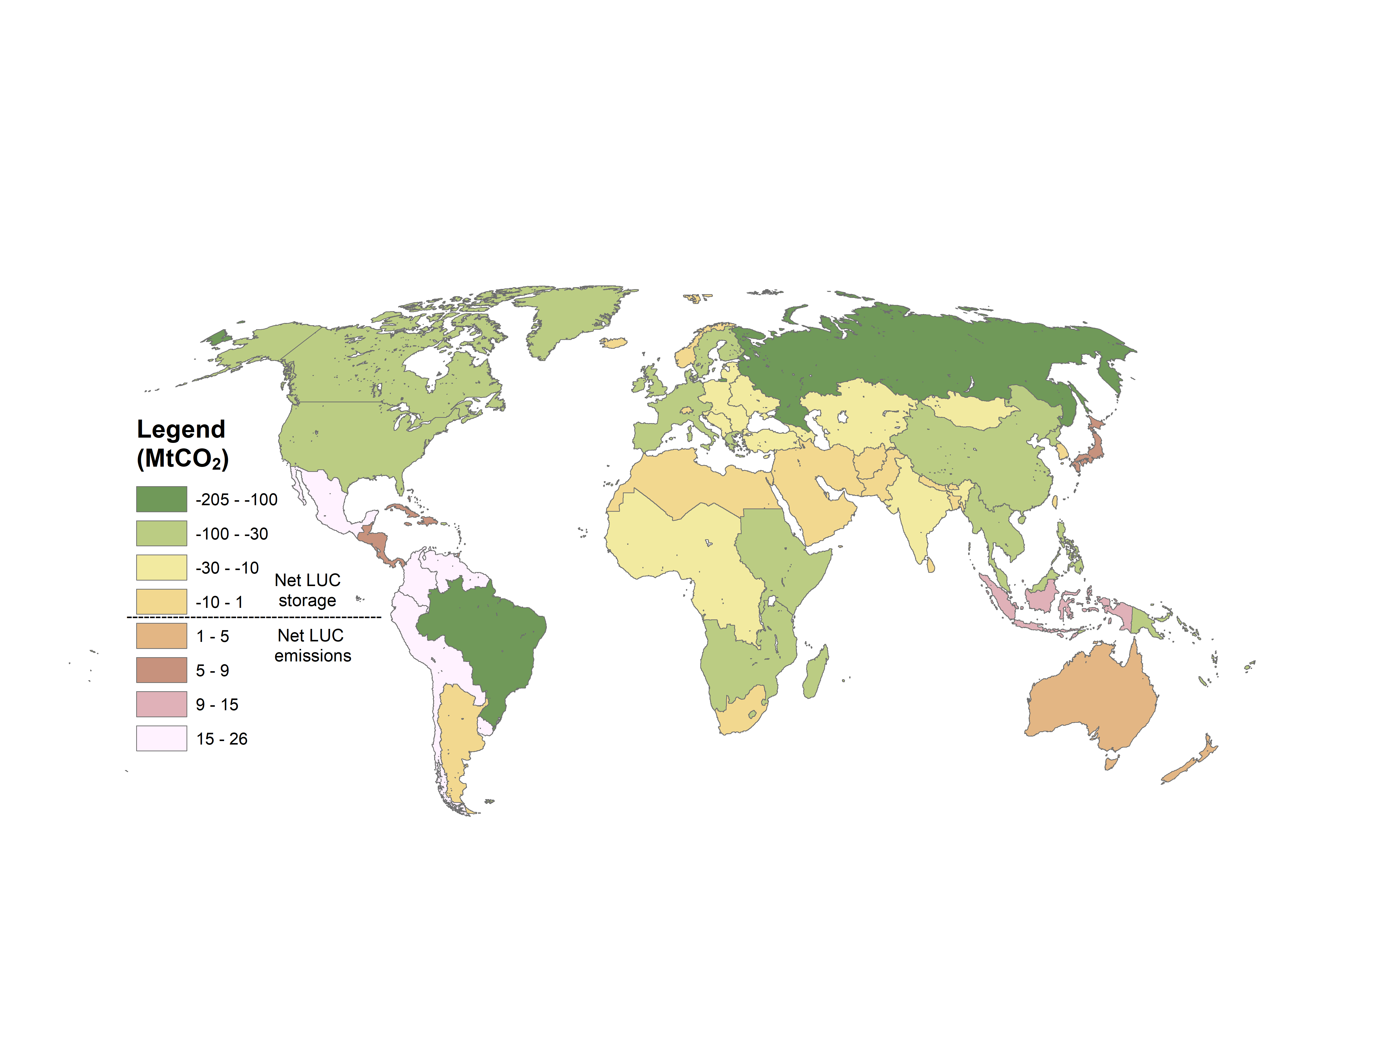
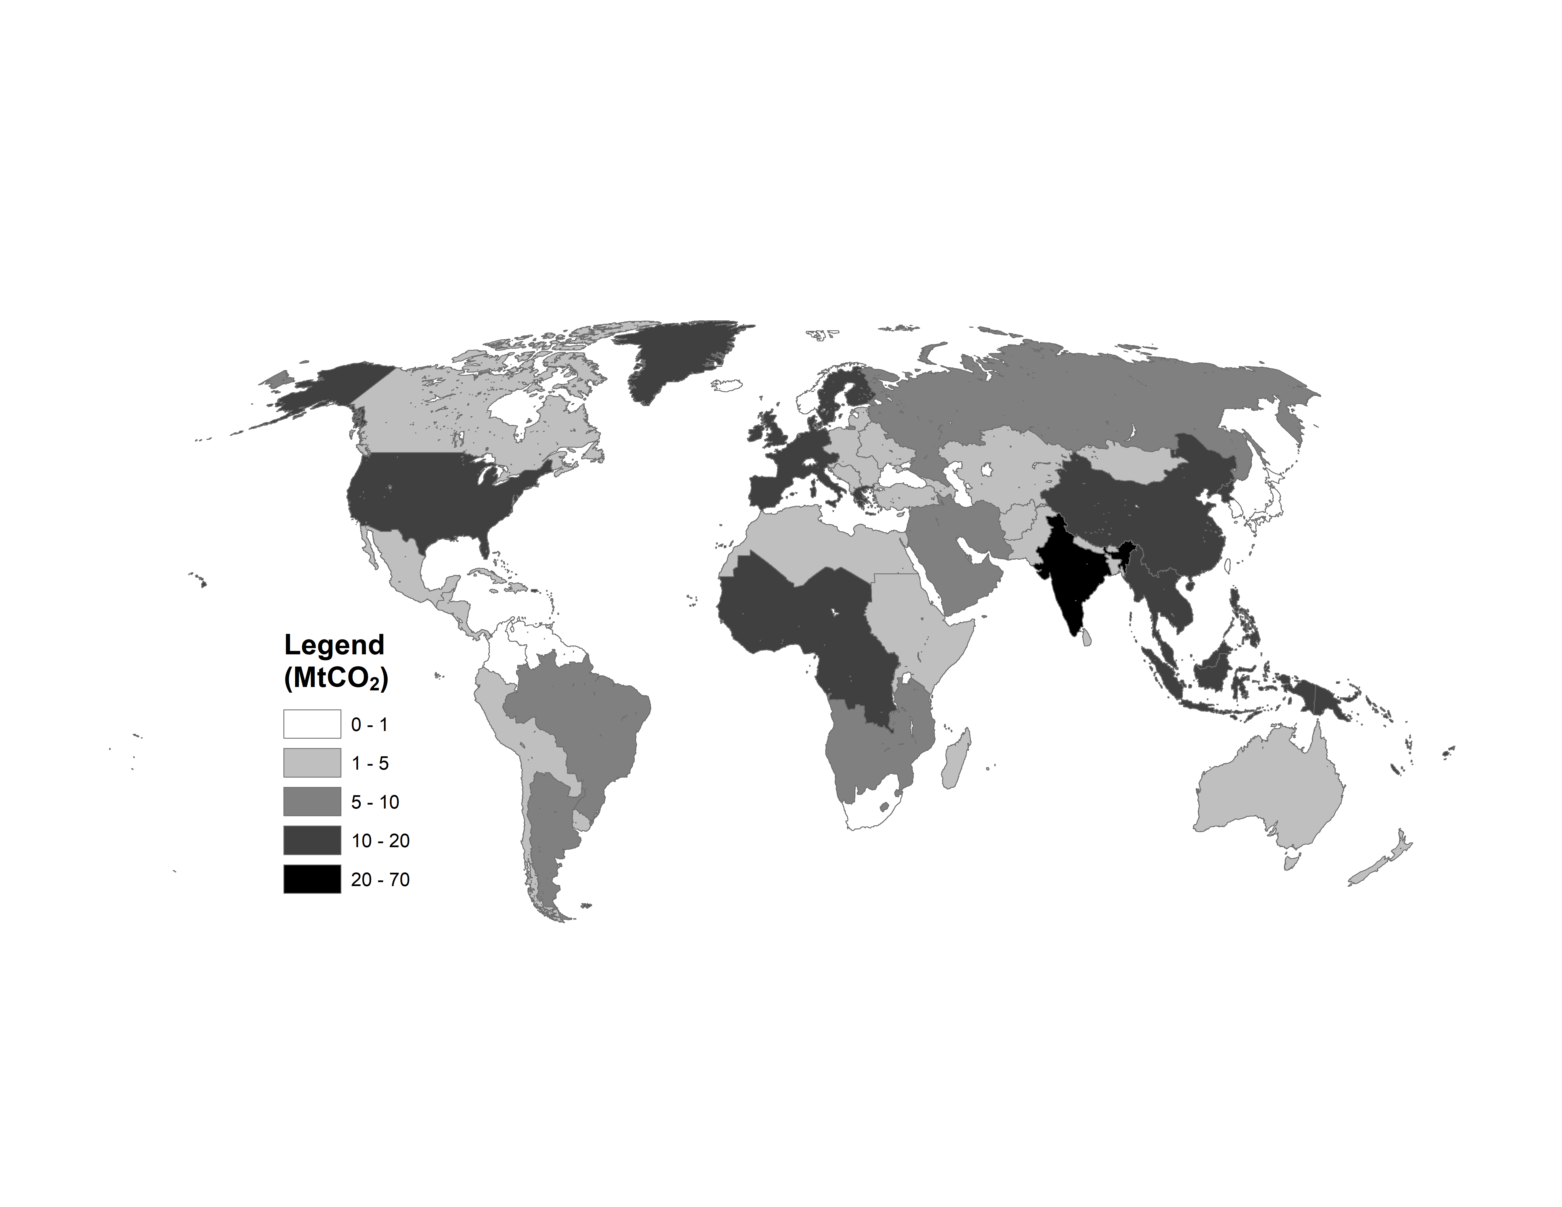
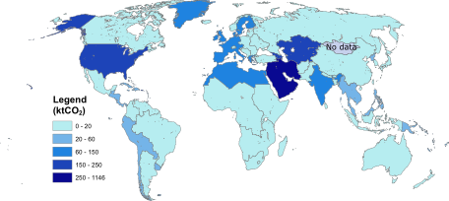
Spatial Patterns of CDR Deployment
BECCS
DACCS
Enhanced Weathering
Land-Use Change
Direct Ocean Capture
Biochar

Slide 9
Course schedule and topics
Date | Lecture Topic (w/ Guest Speaker) | Readings | What’s Due | Paper Critique
8/30 | Introduction to IAM | Reading 1 |  | -
9/6 | Foundations of IAM | Reading 2 | Assignment 1 | -
9/13 | Energy System | Reading 3 |  | -
9/20 | Land System | Reading 4 | Assignment 2 | 박소민
9/27* | Emission System (Prof. Yang Ou) | Reading 5 | Assignment 3 | 조정호
10/4 | GHG Removal | Reading 6 | Assignment 4 | 안지석
10/11 | Water System | Reading 7 |  | 최지우
10/18 | Mid-Term: Project Proposal |  | Project proposal
10/25 | IAM in International Climate Policies | Reading 8 |  | Nguyen
11/1 | Standardized Scenarios | Reading 9 | Assignment 5 | Ahmed
11/8 | Multi-model Comparison | Reading 10 | Assignment 6 | Pei Jia
11/15* | IAM in National Strategies (TBD) | Reading 11 | Assignment 7 | Andhika
11/22 | Mitigation and other SDGs | Reading 12 | Assignment 8 | 이정미
11/29 | Uncertainty in IAM and Climate Change | Reading 13 |  | 박시은
12/6 | Food-Energy-Water Nexus | Reading 14
12/13 | Final project presentation 1 |  | Presentation

Slide 10
Content

Slide 11

Break

Slide 12
Agenda
1:00 Water System
Recap of Previous Lecture
Today’s Lecture
Q&A
2:15 Break
2:30 GCAM Tutorial
Paper Critique
Discuss Previous Assignment
New Modeling Assignment
Proposal writing

Slide 13
Project proposal
Full project proposal is due on October 18. It should include the following components (1 slide each; 5-10 minutes total):
objective/questions of your project;
proposed scenarios;
methodology (assumptions, GCAM inputs to be used, edited);
data required and sources of information;
expected results and conclusions.
Feel free to send me an early idea to see if your proposal would be feasible.
E.g. don’t propose to model Mars climate.
Focus on one region and/or one sector.
Keep it simple, but with room to expand afterwards.

Slide 14
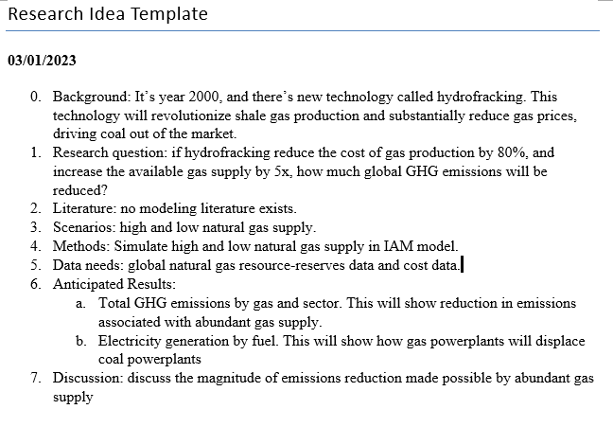

Slide 15
“chatGPT: write a proposal based on this”
Title: Assessing the Impact of Hydrofracking on Global Greenhouse Gas Emissions: A Simulation Study
Background:
Hydrofracking is a new technology that has the potential to revolutionize shale gas production and significantly reduce the cost of gas production, making it a more attractive alternative to coal. Hydrofracking is a process of extracting natural gas from shale rock formations by injecting a high-pressure mixture of water, sand, and chemicals into the rock formations to release the gas. This technology has the potential to increase the available gas supply by five times and reduce the cost of gas production by 80%, leading to the displacement of coal as a primary source of energy.
Research Question:
If hydrofracking reduces the cost of gas production by 80% and increases the available gas supply by 5x, how much global greenhouse gas emissions will be reduced?
Methods:
The study will use an Integrated Assessment Model (IAM) to simulate high and low natural gas supply scenarios to assess the impact of hydrofracking on global greenhouse gas emissions. The IAM model is a widely accepted tool for assessing the impacts of energy policies on the environment, the economy, and society. The model will simulate the impact of hydrofracking on greenhouse gas emissions by sector, including electricity generation, transportation, industry, and residential.
Anticipated Results:
The study is expected to provide the following results:
Total greenhouse gas emissions by gas and sector: This will show the reduction in emissions associated with an abundant gas supply.
Electricity generation by fuel: This will show how gas power plants will displace coal power plants, reducing greenhouse gas emissions associated with electricity generation.
Discussion:
The study will discuss the magnitude of emissions reduction made possible by an abundant gas supply. The findings will be compared with the emissions reduction targets set by various countries and international organizations. The study will also discuss the potential environmental risks associated with hydrofracking, such as water contamination and air pollution, and how these risks can be mitigated.
Conclusion:
The study will contribute to the understanding of the impact of hydrofracking on global greenhouse gas emissions and provide insights into how this technology can be used to mitigate climate change. The findings of the study will be useful for policymakers, energy companies, and environmental organizations in making informed decisions about energy policies and practices.

Slide 16
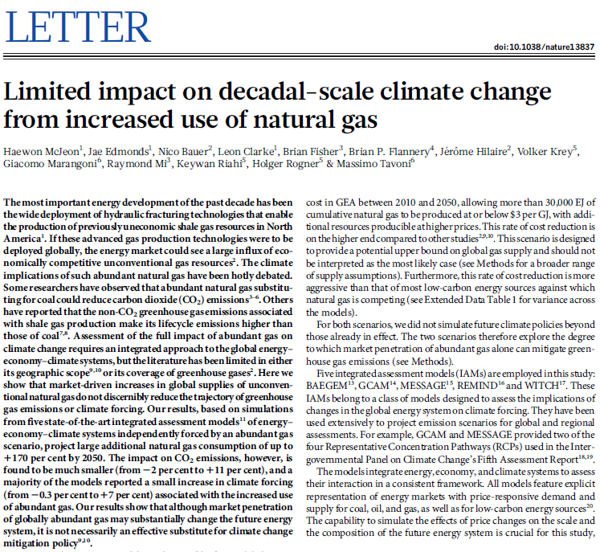
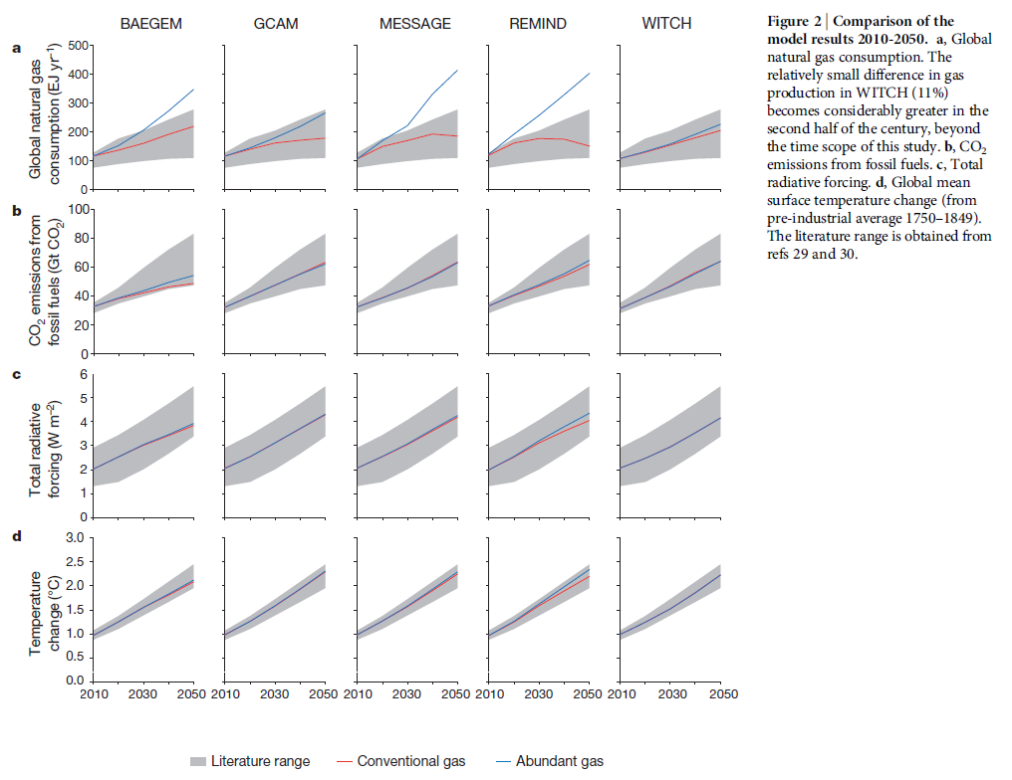

Slide 17
GCAM tutorial – modify input files
https://jgcri.github.io/gcam_training/gcam.html#Scenario_Adjustments

Slide 18
Example 1: Technology costs
Electricity technologies
<global-technology-database>
<input-capital/capital-overnight>: overnight capital costs (i.e., excluding the interest payments required during the construction time), in 1975$ per kW of installed capacity.
Example file: ..input/gcamdata/xml/solar_adv.xml
Transportation technologies
<minicam-non-energy-input/input-cost>: the average levelized cost of transportation, in 1990$ per vehicle-km.
Files Used | Description | Link
transportation_UCD_CORE.csv | XML containing reference transportation technology costs | Link
adjust_ev_tech_cost.xml | XML for modifying 4-wheel passenger BEV costs | Link

Slide 19
Example 2: Electricity generation mix
Set floors and ceilings for electricity generation by fuel:
floors (minimum required generation amounts) for wind and solar
ceiling (maximum generation amount) for coal
*constraint (exact generation amount)
Approach: <policy-portfolio-standard> allows you to set up taxes, subsidies, constraints, and renewable energy standards.
Add-on files:
Configuration.xml:
<Value name = "scen">../input/tech-add-on/electricity_generation_constraints.xml</Value>
<Value name = "scen">../input/tech-add-on/electricity_generation_constraint_techs.xml</Value>
Files Used | Description | Link
indonesia_electricity_generation_constraints.xml | Setting constraints: floors for wind and solar; ceiling for coal | Link
indonesia_electricity_generation_techs.xml | Applying constraints to electricity generation technologies | Link

Slide 20
Example 3: Technology share weights
Share weights are assigned to different subsectors and technology choices in GCAM to represent non-cost factors of consumer choice.
Logit choice function
They are used primarily to calibrate market shares to historical data but can also be modified to reflect factors such as infrastructure development or shifting societal preferences.
They are not directly related to any “real-world” value but often used to represent non-cost-related policies or factors.
Share weights can be assigned with specific values or with interpolation rules (fixed, linear, or s-curve) to automatically interpolate between given years.
Also used as a switch for technology availability (0: not available; all values > 0: available).
Attention! <share-weight year> refers to the “vintage year” of the technology
Example file: ..input/gcamdata/xml/nonewcoal_USA.xml
Files Used | Description | Link
adjust_shareweight_rail.xml | XML for setting passenger rail share weight dynamics | Link

Slide 21
Assignment 7: Modify an input file
Modify an input file of your choice and run GCAM.
Compare results to an existing run without the modification (others equal)
Answer the following questions:
What did you want to model? How did you implement it? (Describe which file(s) you changed and how the input values differ from default)
How does the modification affect your results? Are the changes as you expected? (Look at the directly related queries first)
Does anything else change notably beyond the direct effects? Could you try to explain why? (Also check queries in other systems and/or other regions)

